Slide 1
COS20031
Computing Technology Design Project
Week 03
Relational Modelling Principles

Slide 2
Database Development Lifecycle
Planning
Requirement gathering
Conceptual design
Logical design
Physical design
Construction
Implementation and rollout
Ongoing support

Slide 3
Relational Database Basics

Slide 4
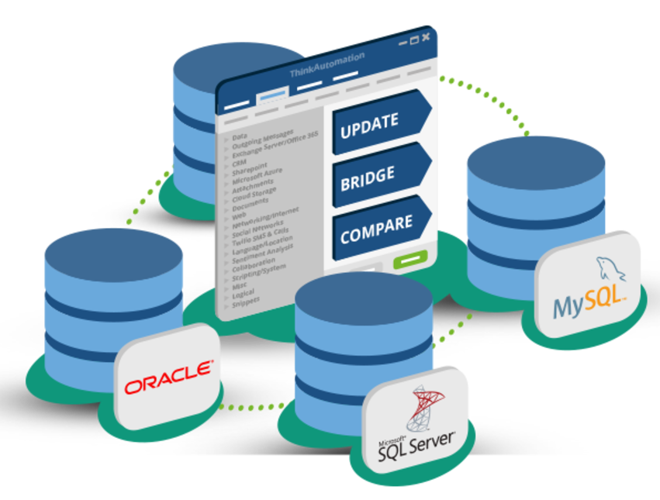
What is a Database?
Definition:
  A collection of individual data items
  Stored in a highly structured way
  Represents a model of reality
  Data can be stored in a single location or hard drive
  Or distributed across large networks
CRUD tasks:
  Create
  Read
  Update
  Delete
  All performed by a database engine

Slide 5
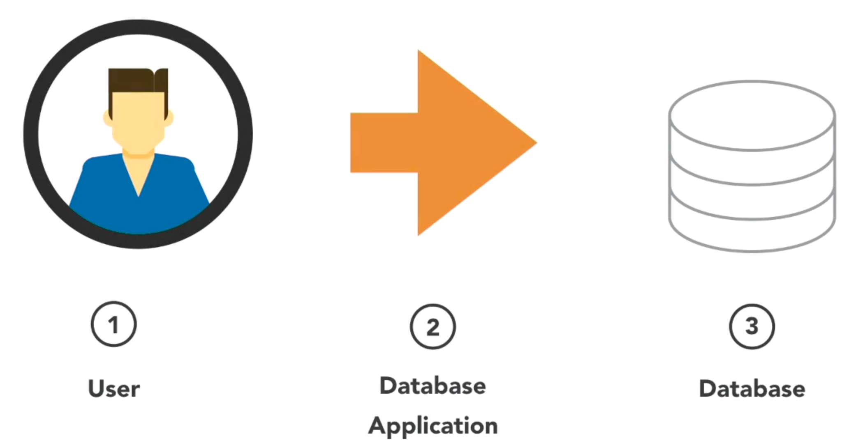
Access Database

Slide 6
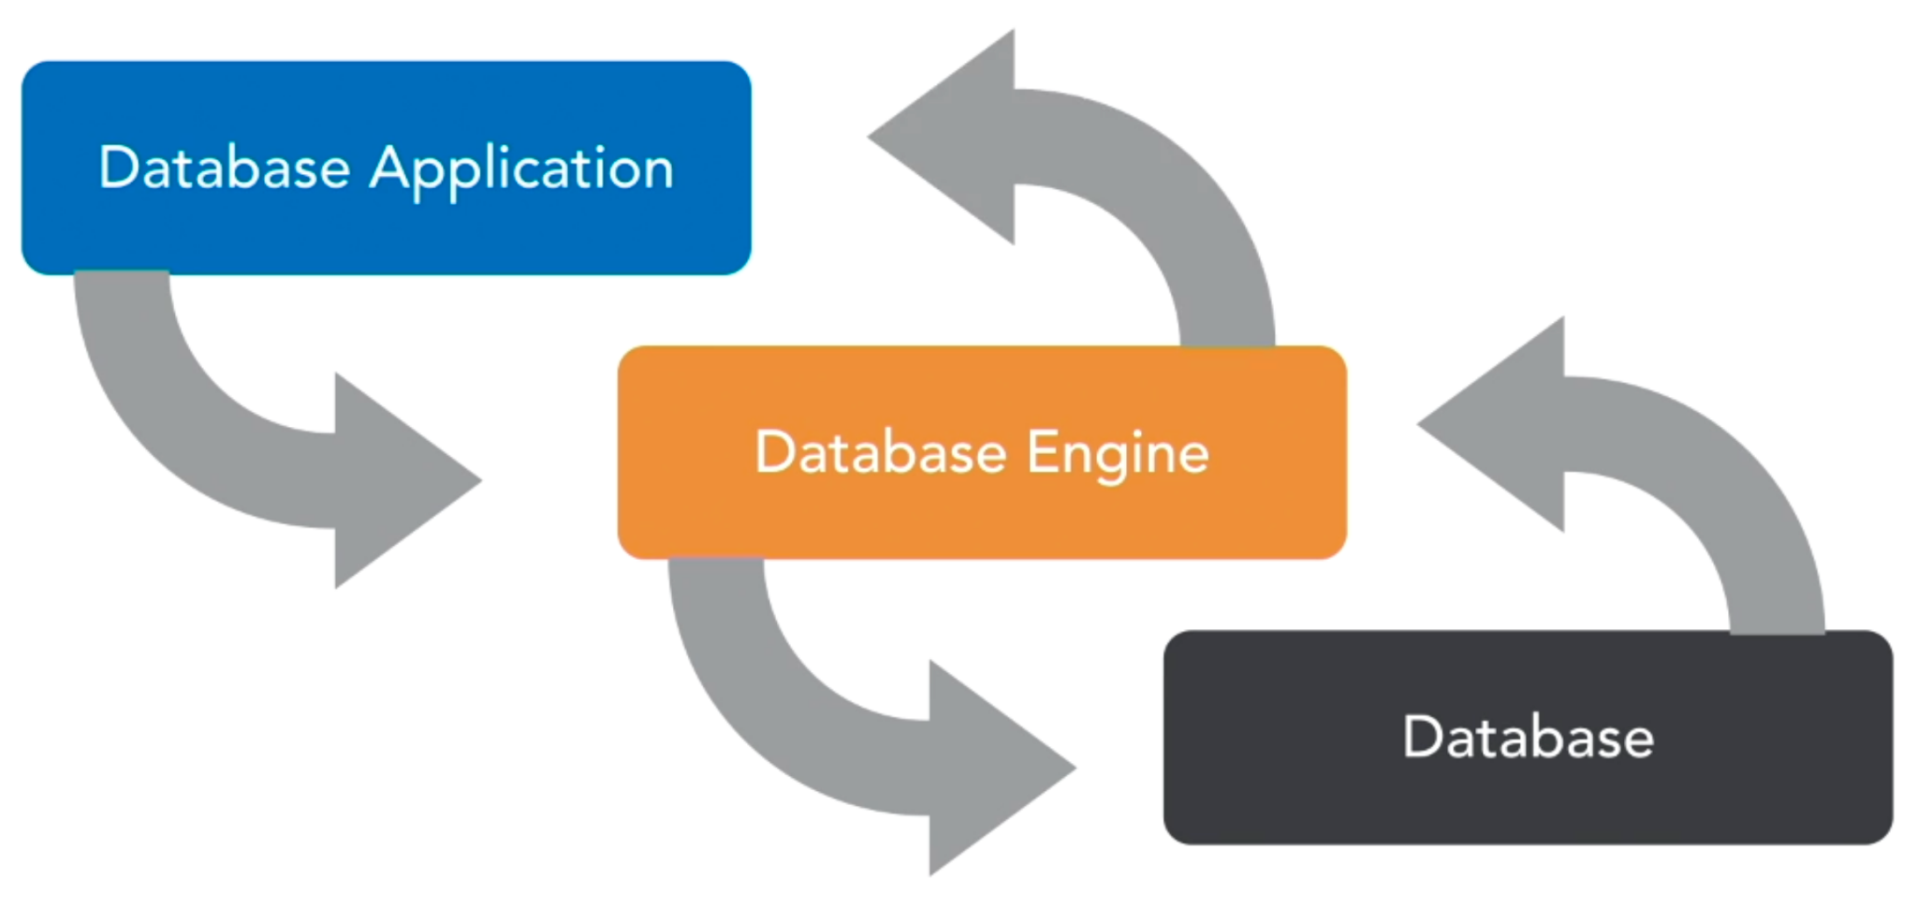
Progress

Slide 7
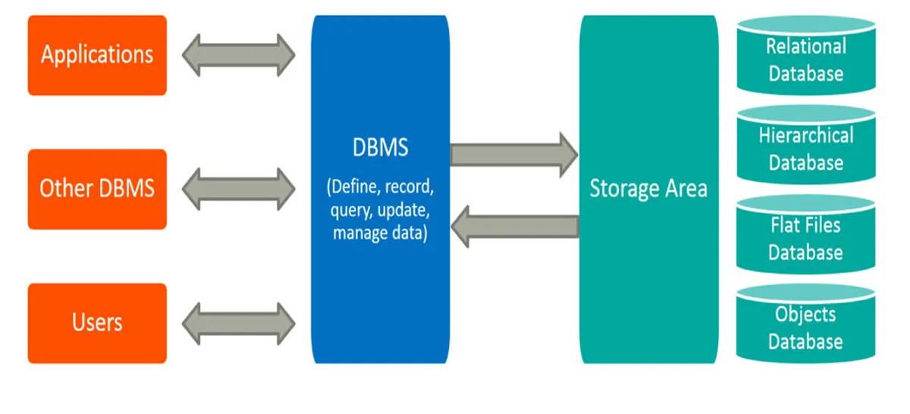
Database Management System
Abbreviated by DBMS
Desktop system such as Microsoft Access
Server-based system such as SQL Server or Oracle

Slide 8

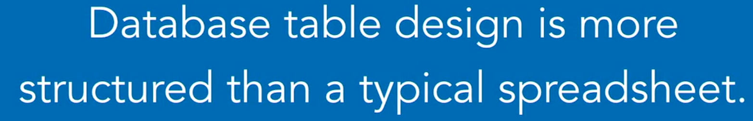
Relational structures
Columns:
  Attributes
  Values
  Fields
  Store a single piece of information
Rows:
  Records
  Made up of a series of values
  Every record represents a single identity

Slide 9
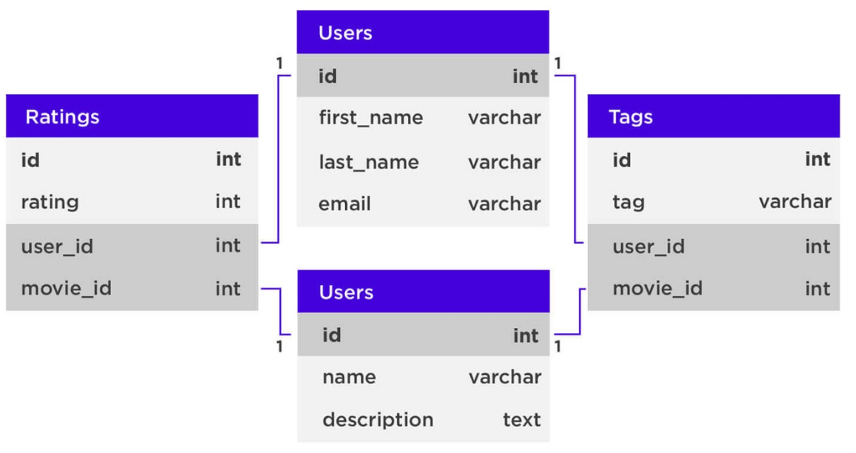
The rules of Relations
Cells contain single values
Columns store a single type of information
Column names are unique
Order is significant
Rows are unique

Slide 10
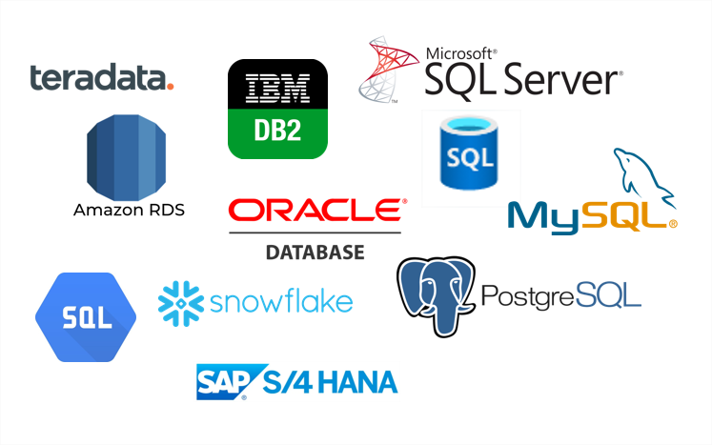
RDBMS Options - System Categories
Server Database Management Systems
  Faster and more robust
  More simultaneous users
  Major server DBMS vendors
    Microsoft SQL server
    Oracle
    DB2
    PostgreSQL
    MySQL
Desktop Database Management Systems
  Easy installation and management
  Designed for lighter weight applicaitons
  Major vendors:
    Microsoft access
    FileMaker Pro
    Base

Slide 11
What is SQL?
Structured Query Language
Used by the DBMS to interact with the database
Create new tables
Insert and update data
Retrieve information across tables
Interacting with the DBMS
  Command-line interface: Requires more upfront understanding of syntax, Easily programmable
  Graphical user interface

Slide 12
How to choose a DBMS?
Use the one your company provides
Conduct research into the features and benefits
Compare implementation costs

Slide 13
(B) Preventing Data Anomalies

Slide 14
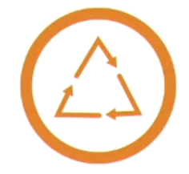
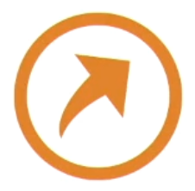

Relational Database Advantages
The database development life cycle outlines the steps to creating a well-considered solution.
Shortcutting the process can lead to undesirable results and wasted effort.
Careful consideration can actually protect the database from mistakes and discrepancies.

Slide 15
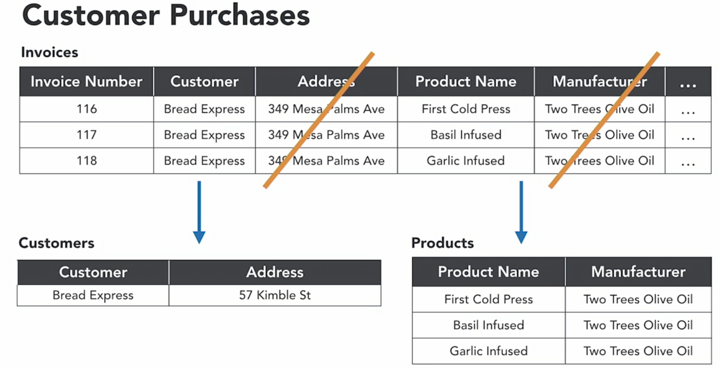
Removing Duplicate Information
WHY?
  Slow performance
  Maintenance issues
  Inconsistencies and anomalies
HOW?
  Remove the dependent column
  Copy the subject column

Slide 16
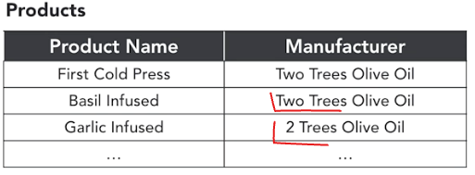
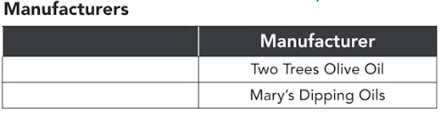
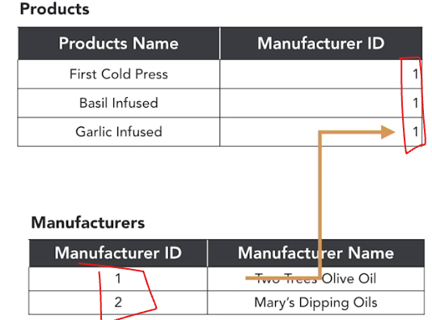
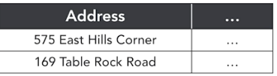
Eliminate Inconsistent Data
Problems:
  Typographic errors, spelling mistakes
  Different entry styles
HOW?
  Make a copy of the redundant information
  Place it into a new table with a clear name

Slide 17
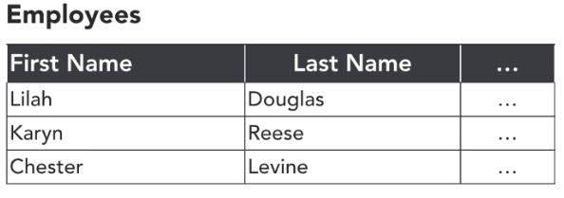
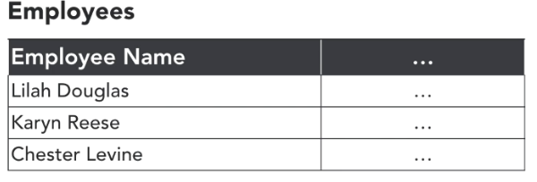
Break Data Down into its components
How to ensure that database remains flexible?
  Making fields as descriptive, and specific, as possible.
  The fields also become quite short and to the point.
Breaking Up Name Fields

Slide 18
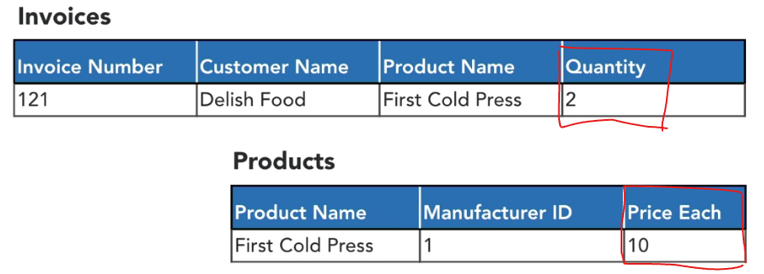
Prevent Data Conflicts
When?
  Stored values are simply calculated from other information that we’re storing or keeping track of.
  One value changes → ensure update the calculation as well.
If Price Each changes → ?
If Quantity changes → ?

Slide 19
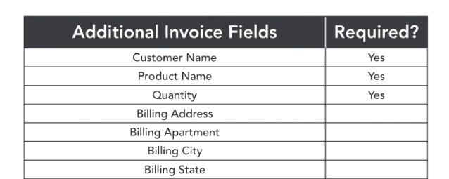
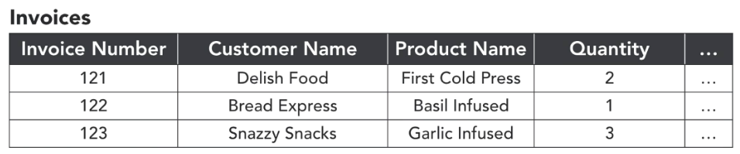
Require Complete Information
WHEN?
  While performing some data entry task and there’s some piece of information that you don’t know.
  You think to yourself, "I'll put in the parts that I know now, "and I'll come back and fill in the rest later." Only you get busy and you move onto other tasks, and completely forget to fill in the blanks.
  Unfortunately this happens all too often to a lot of people.
  We've already seen that incorrect or mistyped data is problematic for a database.
HOW?
  Determine Required Fields

Slide 20
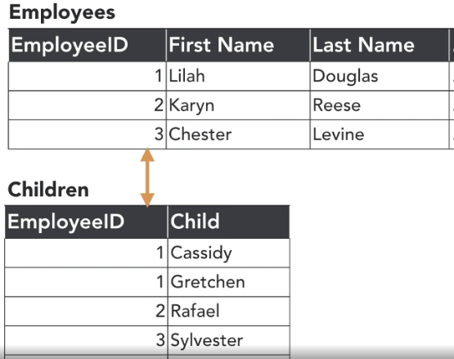
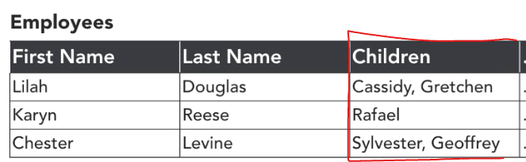
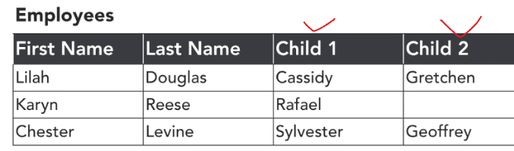
Maintain a consistent structure
Problems?
  Multiple pieces of information of the same type in a single field.
Open/Closed Principles
  Tables should be open for extension and closed for modification.
Resolving Multivalue Fields

Slide 21
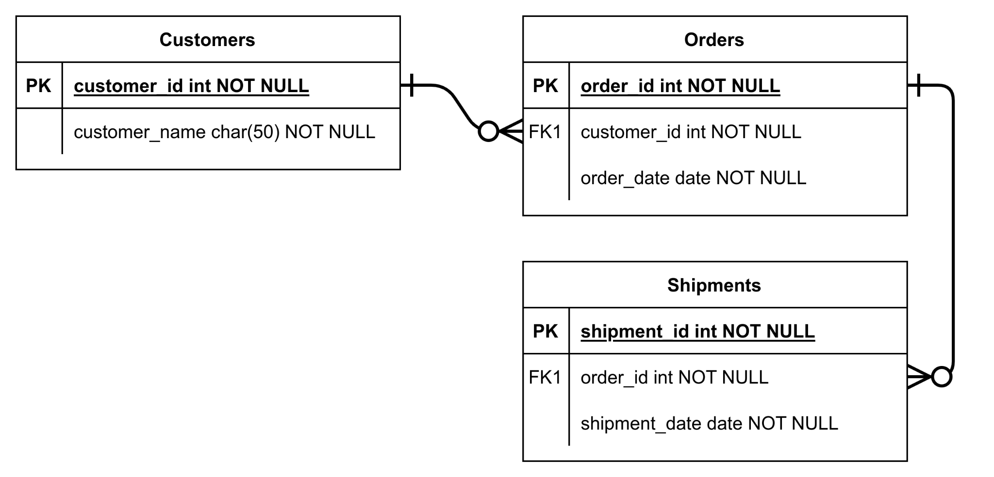
ERD overview
Entity type
Entity
Attribute
Relationship

Slide 22
Tutorial & Workshop
See Canvas.
ERD basics
How to use diagrams.net to draw ERD
Example ERD (maintain a consistent structure)
Integrate diagrams.net with Confluence

